Slide 1
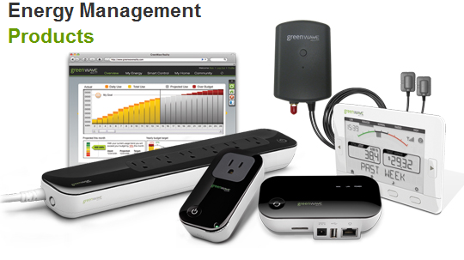
EMS Team Meeting
Johnny Nguyen
Camilo Aguilar
Christian Goldau
Andrew Wang
January 22, 2013

Slide 2
Milestones-Last Quarter
Able to recognize both individual devices, stored in database, and multiple, same devices (ie if there are two footfans fans, identifies there are two fans).
Used Zigbee board to convert input using the ADC, and compute different load signature characteristics using buffers.

Slide 3
Accuracy of the Microcontroller
ADC conversion time:
Tconv = (decimation rate + 16) × 0.25 μs.
Bits Used | Sampling Frequency | Voltage Increment per bit
12 | 972 Hz | 1.46 mV
10 | 3846 Hz | 5.85 mV
9 | 7575 Hz | 11.7 mV
7 | 27777 Hz | 46.8 mV

Slide 4
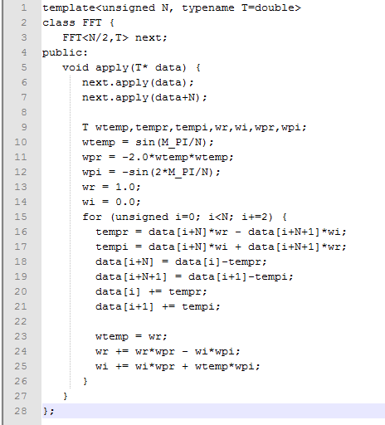
FFT Code vs DFT
N² vs N * log₂ N
Significant time saved
Calculations on board take several seconds

Slide 5
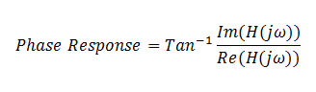
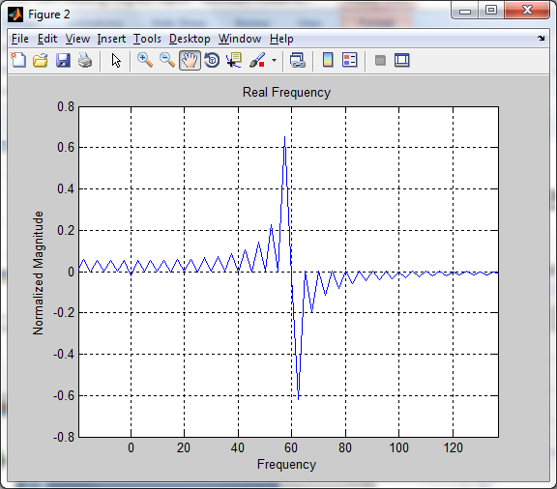
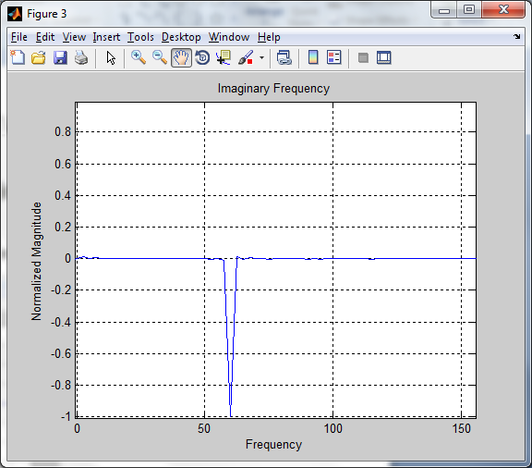
Phase Response
Real and Imaginary Components of FFT utilized

Slide 6
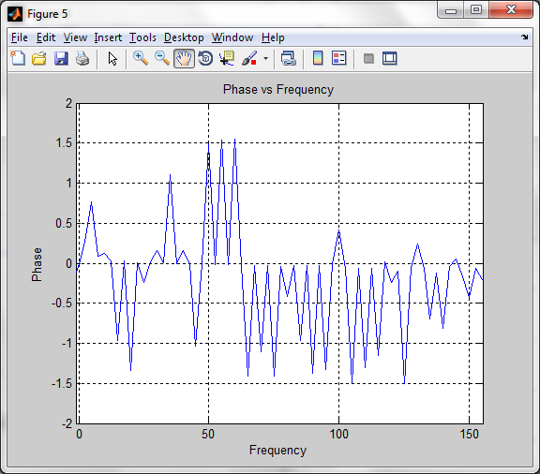
Phase values at 60 Hz, 180 Hz, and 300 Hz similar for 1 Fan, and multiple fan devices
Found that a Laptop and Set-Top-Box with similar other characteristics and similar Harmonics had different phase

Slide 7
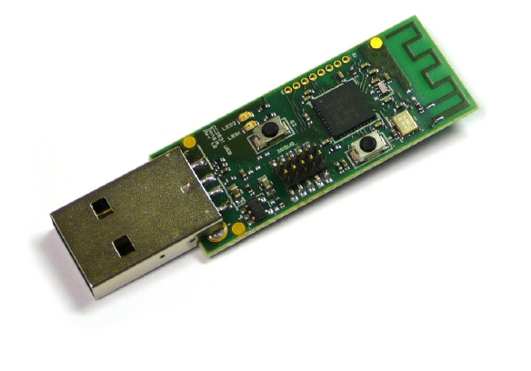
Upcoming tasks
First Priority: USB interface
View stored values in microcontroller
DC Offset
Can double efficiency
Implement Phase Characteristics and FFT (instead of DFT) on controller

